Slide 1
Natural language processing
Lecture 3: Word embeddings
Roberta Rocca
Assistant Professor, IMC & CHC
✉️ roberta.rocca@cas.au.dk
Notes:
A “fractal” view on word2vec, where we start from the overall intuition, and we dive increasingly deeper into the architecture

Slide 2
Recap: distributional semantics models
Distributional semantics is a useful way to think about meaning, as it allows to translate meaning into computational representations
A simple implementation: represent words as vectors of co-occurrence counts (in documents or in windows) with other words
The same applies to representing documents (e.g., for information retrieval)
There are a few downsides to this, chief among them dimensionality and sparsity
Vectors can be compressed and densified using dimensionality reduction (SVD)

Slide 3
Recap: vector spaces
Vector representations have a spatial interpretation
Spatial relations between vectors reflect semantic relations between words
Similarity is the most important example – quantified, e.g., using cosine similarity
Composite dimensions in vector spaces also mirror semantic & syntactic relations
There are several ways to evaluate if word vectors are good
Intrinsic evaluation (e.g., do they capture basic word analogies?)
Extrinsic evaluation (e.g., named-entity recognition) on end-user tasks

Slide 4
Today’s plan
How to build better, natively “dense” representations?
Count-based vs. prediction-based approach
Word2Vec (the most popular word embedding model)
High-level logic
Skipgram with softmax
Skipgram with negative sampling
Word2Vec as neural network!
Open issues

Slide 5
Pros and cons of count-based models
Leverages simple information embedded in corpus statistics
Relatively fast training
Sparsity and dimensionality are pretty serious issues
The normalization pipeline has a lot of moving parts and it is not infinitely scalable
Disproportionate importance given to very large counts

Slide 6
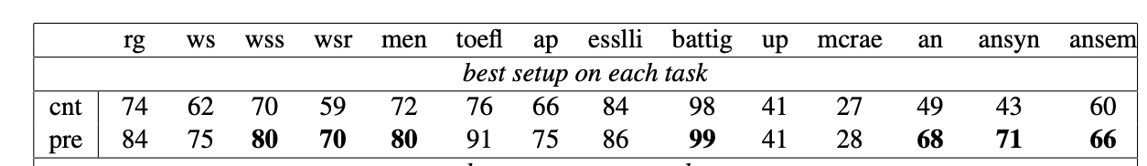
Performance is good,
but not great
rank correlation in
semantic relatedness
purity in categorization task
accuracy in semantic analogy

Slide 7
Inferring vectors through context prediction
Instead of building vectors of co-occurrences, we train a model solving a classification problem
Given a word c (e.g., mind), predict how likely it is to find a word w within a window of size n
Don’t count how many times w occur, train a classifier that predicts how likely they are to occur around mind
The most popular approach to doing this is word2vec
The resulting vectors are dense and short meaning representations, with better performance across the spectrum

Slide 8
High-level overview of word2vec
Large text corpus for training (e.g., the entire Wikipedia)
Randomly initialize n-dimensional vectors for each word in your vocabulary
Iterate over text using a window of size n
Let c be the central word in that window and o the surrounding words…
.. can you infer which words are included in the window, based on the vector for c?
If predictions are off, the error is used as training signal to update the vectors
… there was no doubt in his mind that the man was serious …

Slide 9
High-level overview of word2vec
Large text corpus for training (e.g., the entire Wikipedia)
Randomly initialize n-dimensional vectors for each word in your vocabulary
Iterate over text using a window of size n
Let c be the central word in that window and o the surrounding words…
.. can you infer which words are included in the window, based on the vector for o?
If predictions are off, the error is used as training signal to update the vectors
… there was no doubt in his mind that the man was serious …

Slide 10
High-level overview of word2vec
Large text corpus for training (e.g., the entire Wikipedia)
Randomly initialize n-dimensional vectors for each word in your vocabulary
Iterate over text using a window of size n
Let c be the central word in that window and o the surrounding words…
.. can you infer which words are included in the window, based on the vector for o?
If predictions are off, the error is used as training signal to update the vectors
… there was no doubt in his mind that the man was serious …

Slide 11
High-level overview of word2vec
Large text corpus for training (e.g., the entire Wikipedia)
Randomly initialize n-dimensional vectors for each word in your vocabulary
Iterate over text using a window of size n
Let c be the central word in that window and o the surrounding words…
.. can you infer which words are included in the window, based on the vector for o?
If predictions are off, the error is used as training signal to update the vectors
p(v_{c-2}|v_{c})
p(v_{c+1}|v_{c})
maximize probability for true context words
… there was no doubt in his mind that the man was serious …
v_{c}
Note: a typical word2vec window size would be 5

Slide 12
Another flavor of word2vec
Large text corpus for training (e.g., the entire Wikipedia)
Randomly initialize n-dimensional vectors for each word in your vocabulary
Iterate over text using a window of size n
Let c be the central word in that window and o the surrounding words…
… can you infer which word is c, based on vectors for o and c words?
… there was no doubt in his mind that the man was serious …
p(v_{c} | v_{c-2} … v_{c+2})

Slide 13
Another flavor of word2vec
Large text corpus for training
Randomly initialize n-dimensional vectors for each word in your vocabulary
Iterate over text using a window of size n
In both cases, we don’t really care about the prediction task: this is just a proxy task to learn good parameters/weights in a neural network classifier…
These parameters/weights are the word vectors

Slide 14
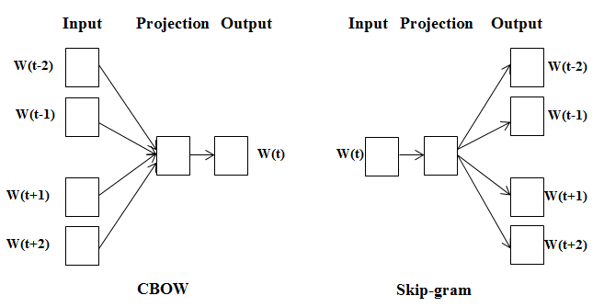
Skip-gram vs CBOW
Word2Vec comes in two flavours: Skip-gram and continuous bag-of-words (CBOW)
CBOW: “Given context c what is the most likely word w?”
Skip-gram: “Given word w, what is the most likely context c?”
Skip-gram tends to perform better on smaller data and with rarer words; CBOW on large data and frequent words

Slide 15
Why is this approach better that counting?
It yields better performance across the spectrum
Smaller and dense vectors
… you never need to store or output huge matrices
… dense representations tend to generalize better
It makes it virtually possible to scale the size of training corpora indefinitely

Slide 16
Before we start, let’s take a look at a vector space, to see the outcome of this process.
https://projector.tensorflow.org/

Slide 17
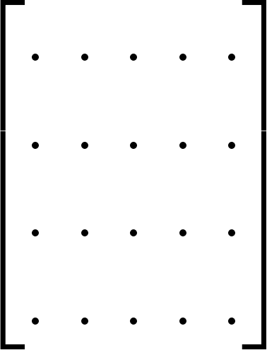
Skip-gram: overall logic
Let’s focus on the skip-gram version of this model, and let’s get an intuitive understanding of how this works.
“center” vectors (V)
“context” vectors (U)
vocabulary (W)
n_dims
n_dims
{‘aardvark’: 1,
‘abacus’: 2,
‘apricot’: 3,
…
‘zebra’: n}
n_words
n_words
this is where we get vectors for the center word
this is where we get vectors for the context words

Slide 18
Skip-gram, version 1: softmax
Extract the vector representing the center word c from V
Extract the vectors representing the context words o from U
We want to compute the probability of each o being in the context of c, using their vectors
We want high probability of co-occurrence for words that do co-occur with c in the data
We compute the dot product of any pair of center/context vectors, and apply some additional transformation that turns these quantities into probabilities
Are these probabilities high? If not, we need to update our vectors!
Notes:
RATIONALE: If vectors reflect their meaning, probabilities of co-occurrences based on vectors must be high… similar

Slide 19
Skip-gram, version 2: negative sampling
Extract the vector representing the center word c from V
Extract the vectors representing the context words o from U
For each context word, we sample n words from the vocabulary which are not part of c’s context (negative samples)
We want to compute the probability of positive samples and negative samples being in the context of c
We want positive samples to yield high probability, and negative samples to yield low probability
We compute the dot product of each pair of vectors, and apply some additional transformation that turns these quantities into probabilities
Are these probabilities high for true context words and low for negative samples? If not, we need to update our vectors!
Notes:
If vectors reflect their meaning, probabilities of co-occurrences based on vectors must be high

Slide 20
Skip-gram, version 2: negative sampling
Extract the vector representing the center word c from V
Extract the vectors representing the context words o from U
For each context word, we sample n words from the vocabulary which are not part of c’s context (negative samples)
We want to compute the probability of positive samples and negative samples being in the context of c
We want positive samples to yield high probability, and negative samples to yield low probability
We compute the dot product of each pair of vectors, and apply some additional transformation that turns these quantities into probabilities
Are these probabilities high for true context words and low for negative samples? If not, we need to update our vectors!
As we will see, this is computationally less expensive than softmax, and therefore the default approach for word2vec
Notes:
If vectors reflect their meaning, probabilities of co-occurrences based on vectors must be high

Slide 21
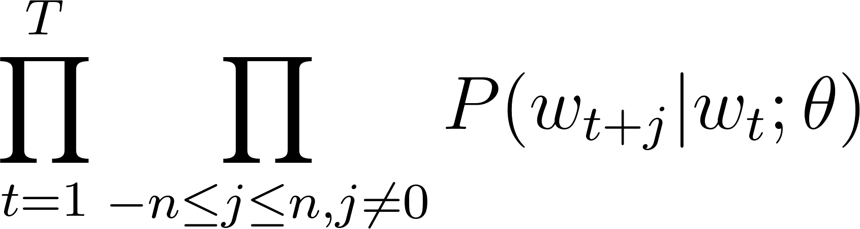
Skip-gram with softmax
Goal: learn two matrices V and U that maximize the likelihood of the data.
Given a window size n, you want to find the parameters theta that maximize the following quantity [this will also be a way to quantify how well your model is doing]
Notes:
How do we operationalize the idea of maximizing joint probability for words that occur together? How do we assess that?
The likelihood is a way to assess how good our parameters are – it is a function that expresses the joint probability of the observed data. A good set of parameters is one that maximizes the probability of the observed data…. Very high level, the idea is that we want our model to be able to reproduce our data as well as possible!

Slide 22
Skip-gram with softmax
Goal: learn two matrices V and U that maximize the likelihood of the data.
Given a window size n, you want to find the parameters theta that maximize the following quantity [this will also be a way to quantify how well your model is doing]
… there was no doubt in his mind that the man was …
P(was|doubt) * P(no|doubt) * P(in|doubt) * P(his|doubt)
… calculated as a function of the parameters theta (here, the center and context vectors)...
this is the probability of any of the words in the context window occurring if the center word occurs, given a set of parameters (the two vector matrices) theta used to calculate the probability
Notes:
The likelihood is a way to assess how good our parameters are – it is a function that expresses the joint probability of the observed data. A good set of parameters is one that maximizes the probability of the observed data…. Very high level, the idea is that we want our model to be able to reproduce our data as well as possible!

Slide 23
Skip-gram with softmax
Goal: learn two matrices V and U that maximize the likelihood of the data.
Given a window size n, you want to find the parameters theta that maximize the following quantity [this will also be a way to quantify how well your model is doing]
… there was no doubt in his mind that the man was …
P(was|doubt) * P(no|doubt) * P(in|doubt) * P(his|doubt)
… calculated as a function of the parameters theta (here, the center and context vectors)...
this is the probability of any of the words in the context window occurring if the center word occurs, given a set of parameters (the two vector matrices) theta used to calculate the probability
this just means you repeat this as you run your sliding window along the data
Notes:
The likelihood is a way to assess how good our parameters are – it is a function that expresses the joint probability of the observed data. A good set of parameters is one that maximizes the probability of the observed data…. Very high level, the idea is that we want our model to be able to reproduce our data as well as possible!

Slide 24
Skip-gram with softmax
but how do we compute this?
… there was no doubt in his mind that the man was …
P(was|doubt) * P(no|doubt) * P(in|doubt) * P(his|doubt)
… calculated as a function of the parameters theta (here, the center and context vectors)...
this is the probability of any of the words in the context window occurring if the center word occurs, given a set of parameters (the two vector matrices) theta used to calculate the probability
this just means you repeat this as you run your sliding window along the data

Slide 25
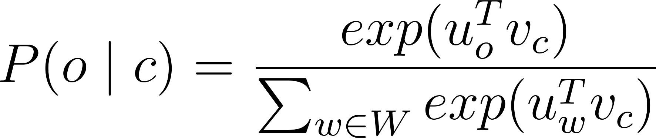
Skip-gram with softmax
dot product of the vector for the context word (u_{o}) and the vector for the center word (v_{c}). This is proxy for similarity. When this is larger, the probability is larger → optimizes for vectors yielding high similarity for related words
context word
makes any number positive
“Normalization”: this is computed over the whole vocabulary W and it results in a probability distribution
center word
Notes:
Dot product can be negative if dimensions are negative… ALSO: note that the denominators disincentivizes the model to give high cosine product to ALL vectors (as we are not minimizing probability for words that do not occur together)

Slide 26
Skip-gram with softmax
this is an instantiation of the softmax function, commonly used in neural nets for probabilistic multi-class classification (convert numerical scores into a probability distribution)
Notes:
Remember to explain why…. This maps into a quantity from zero to 1 (it is because the denominator is at least equal to the numerator)

Slide 27
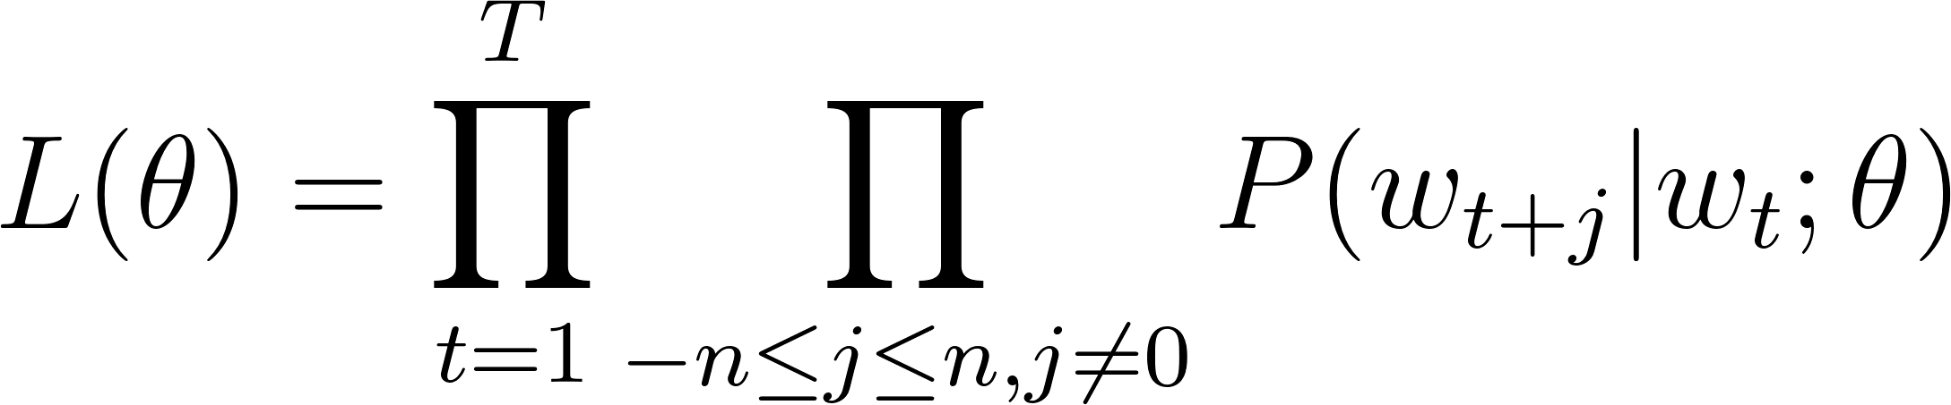
Skip-gram with softmax
Notes:
Convenience… i.e., very small probabilities, vanishing gradients and computer precision

Slide 28
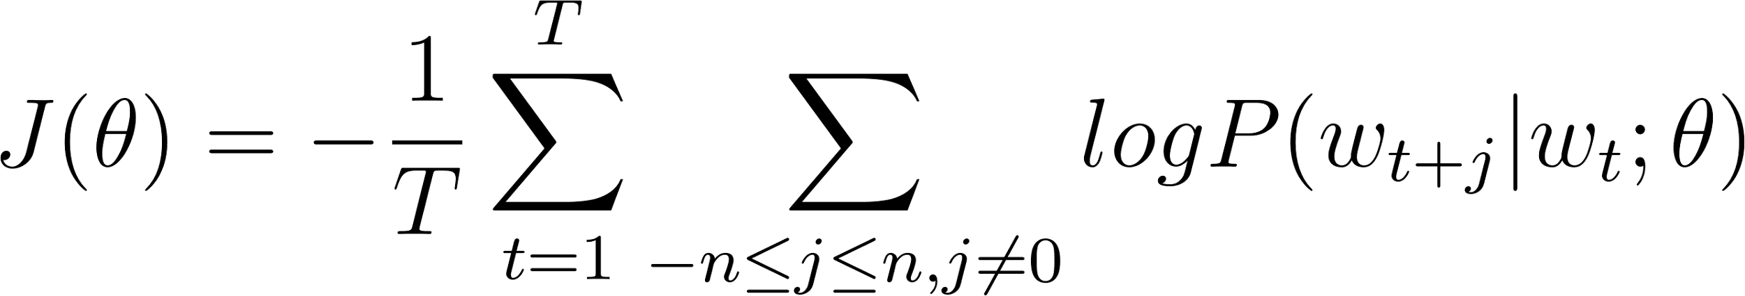
Skip-gram with softmax
we want to maximize this, but for convenience we tackle an equivalent problem, i.e., minimizing the negative log of this quantity (its minimum is zero, so we want it to be as close as possible to zero)
Because log(a*b) = log(a) + log(b)
Notes:
Convenience… i.e., very small probabilities, vanishing gradients and computer precision

Slide 29
Skip-gram with softmax
plug in

Slide 30
Skip-gram with softmax
plug in
This is the cost function, which the model uses to learn how well is doing using the current vectors.
For all windows, the model computes this. If the value is high, the model is not doing so well.
The magnitude of the result is used by the model to update the weights through mechanisms called gradient descent and backpropagation (more later!)
After updating, the model tries again, until it converges on good vectors.

Slide 31
Skip-gram with softmax
plug in
This is the cost function, which the model uses to learn how well is doing using the current vectors.
For all windows, the model computes this. If the value is high, the model is not doing so well.
The magnitude of the result is used by the model to update the weights through mechanisms called gradient descent and backpropagation (more later!)
After updating, the model tries again, until it converges on good vectors.
forward pass
backward pass

Slide 32
Skip-gram with negative sampling (SGNS)
Softmax requires computing a probability distribution over the entire vocabulary at each step of the training procedure
Negative sampling is a “lightweight” alternative, which does not use the softmax
The logic is the following:
For each “positive example” (each word that does co-occur with c in a given window)
We sample k “negative examples” (words in the vocabulary which are not in the target window)
We independently compute probability of co-occurrence for both positive and negative examples
Our cost function should reward high probabilities for positive examples, and low probabilities for negative examples

Slide 33
Skip-gram with negative sampling (SGNS)
… there was no doubt in his mind that the man was …
sampled from vocabulary W
negative word (n₁): “apple”
positive word (c): “no”
negative word (n₂): “computer”
negative word (n_{k}): “syllabus”

Slide 34
Skip-gram with negative sampling (SGNS)
… there was no doubt in his mind that the man was …
sampled from vocabulary W
negative word (n₁): “apple”
positive word (c): “no”
negative word (n₂): “computer”
negative word (n_{k}): “syllabus”
the model can learn from both “positive signals” (sometimes uninformative) and “negative signals” (words that are not related)
sampling by frequency (raised to the power of ¾ and normalized by vocabulary size to downweight sampling of highly frequent words)

Slide 35
Skip-gram with negative sampling (SGNS)
… there was no doubt in his mind that the man was …
sampled from vocabulary W
negative word (n₁): “apple”
positive word (c): “no”
negative word (n₂): “computer”
negative word (n_{k}): “syllabus”
training example

Slide 36
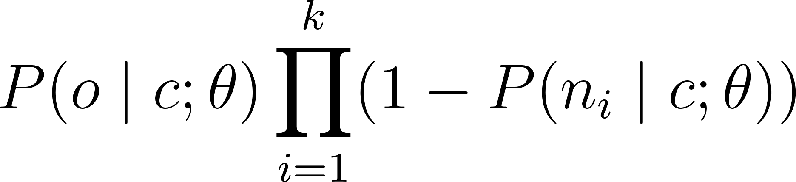
SNGS: objective function (single example)
This time, the likelihood function (which we want to maximize) will looks like this, for a single example (where o is the center word, and k a set number of negative samples):
this is the probability of negative examples not being in the context of c

Slide 37
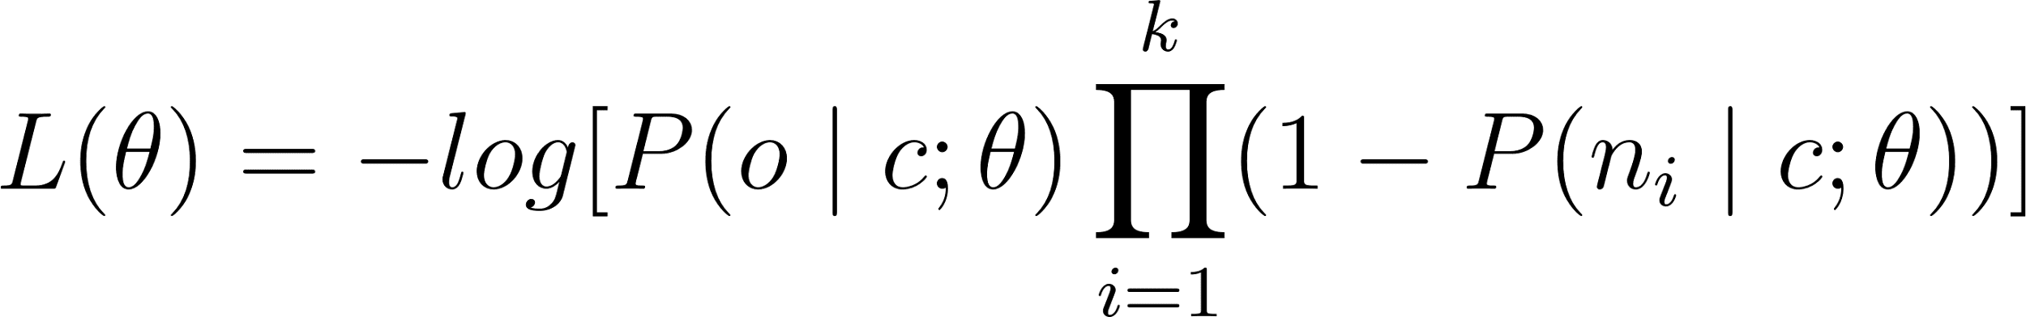
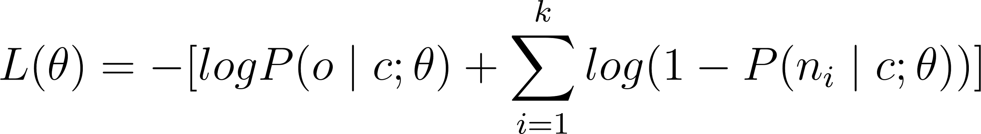
SNGS: objective function (single example)
As before, for convenience we minimize the negative log of that.
[Why? 1. This directly translates into a loss (with 0 as minimum value); 2. Products are tricky: they can get very small, and computers don’t have the necessary precision to represent them. ]
Notes:
Remember: we want the quantity inside the parenthesis to be maximized, which means being close to zero, as its maximum is zero. How is that zero? It is zero if the stuff inside the log is as close as possible to 1 – aka, if the probability of the positive example is high, and the probability of the negative examples is 0.

Slide 38
SNGS: objective function (single example)
As before, for convenience we minimize the negative log of that.
[Why? 1. This directly translates into a loss (with 0 as minimum value); 2. Products are tricky: they can get very small, and computers don’t have the necessary precision to represent them. ]
how do we compute these probabilities?
we want this to be close to 1
we want this to be close to 0
Notes:
Remember: we want the quantity inside the parenthesis to be maximized, which means being close to zero, as its maximum is zero. How is that zero? It is zero if the stuff inside the log is as close as possible to 1 – aka, if the probability of the positive example is high, and the probability of the negative examples is 0.

Slide 39
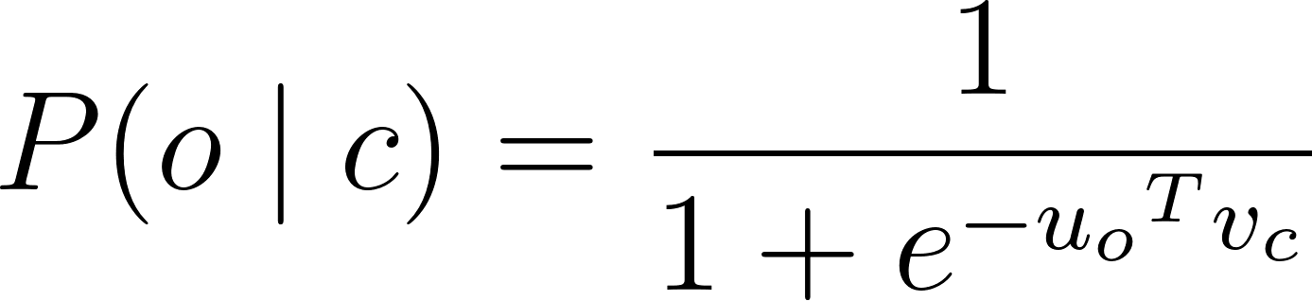
SNGS: objective function (single example)
this is the same dot product we have seen before. To maximize P(o|c), this has to be very high – i.e., vectors of words occurring together should yield a high dot product
Notes:
Very high because so exp(x) is zero if x is very negative

Slide 40
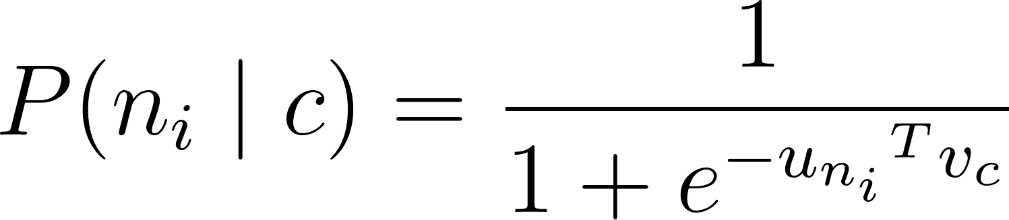
SNGS: objective function (single example)
this is the same dot product we have seen before. To minimize P(n_{i}|c), this has to be very low – i.e., vectors of words not occurring together should yield a very low dot product
Different from softmax, in SNGS we are only calculating one dot product!

Slide 41
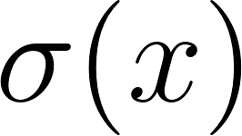
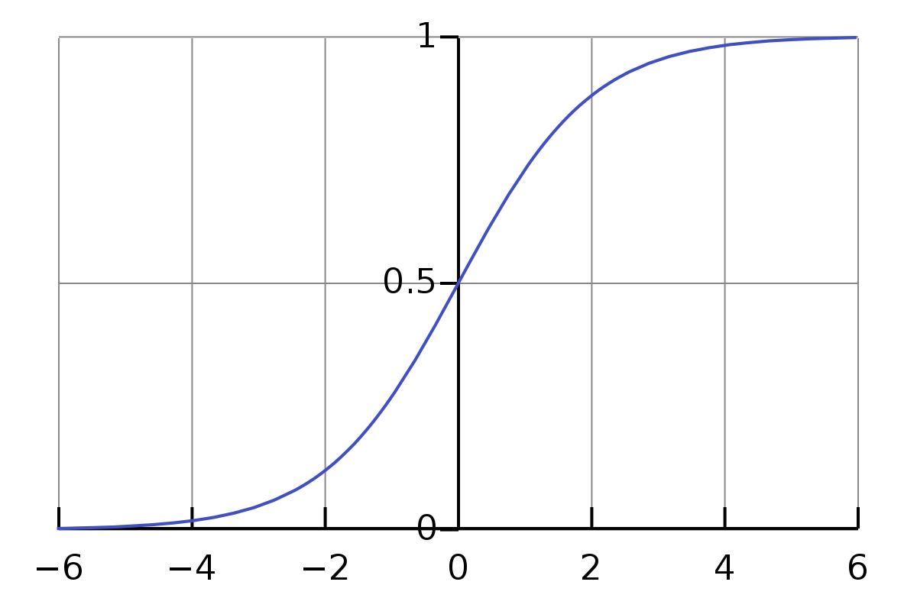
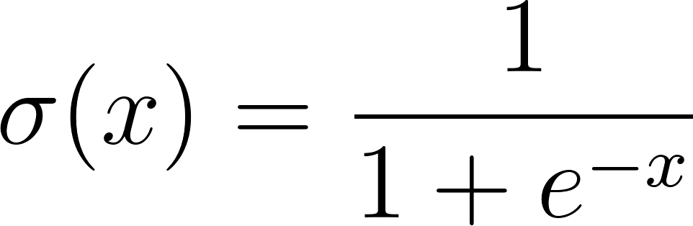

SNGS: sigmoid/logistic function
What we are doing here is applying the sigmoid function to the dot product of the two vectors
Transforms any real number x into a number between 0 and 1
These can be interpreted as a probability!
This is the basis of binary classification with neural nets
Notes:
Logistic is a speicifc type of sigmoid (tanh is also sigmoid...)

Slide 42
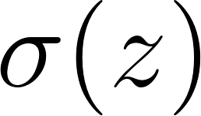
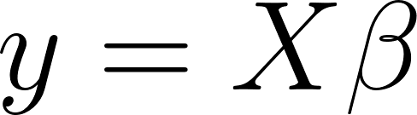

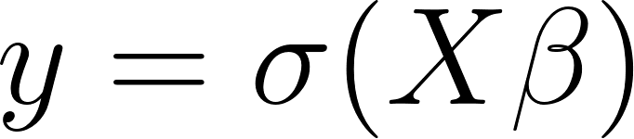

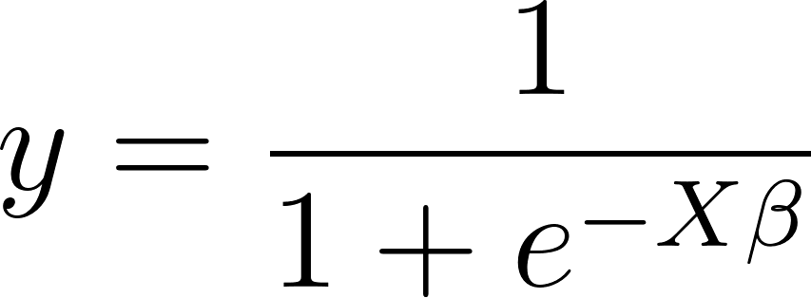
Intermezzo: sigmoid/logistic function
Remember: the sigmoid/logistic function is the link function for logistic regression!
Linear regression (output is (-∞,+∞))
threshold for binarization
Logistic regression
(output is bound between 0 and 1, can be binarized to probability)
i.e.,

Slide 43
SNGS: objective function (single example)
Notes:
Remember: we want the quantity inside the parenthesis to be maximized, which means being close to zero, as its maximum is zero. How is that zero? It is zero if the stuff inside the log is as close as possible to 1 – aka, if the probability of the positive example is high, and the probability of the negative examples is 0.

Slide 44
SNGS: objective function (single example)
Notes:
Remember: we want the quantity inside the parenthesis to be maximized, which means being close to zero, as its maximum is zero. How is that zero? It is zero if the stuff inside the log is as close as possible to 1 – aka, if the probability of the positive example is high, and the probability of the negative examples is 0.

Slide 45
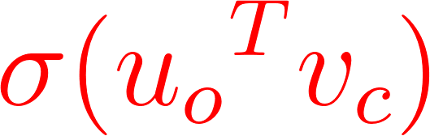
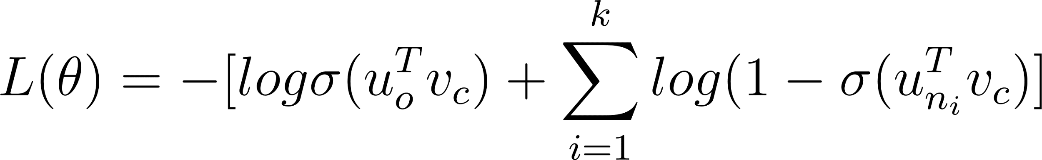
SNGS: objective function (single example)
Notes:
Remember: we want the quantity inside the parenthesis to be maximized, which means being close to zero, as its maximum is zero. How is that zero? It is zero if the stuff inside the log is as close as possible to 1 – aka, if the probability of the positive example is high, and the probability of the negative examples is 0.

Slide 46
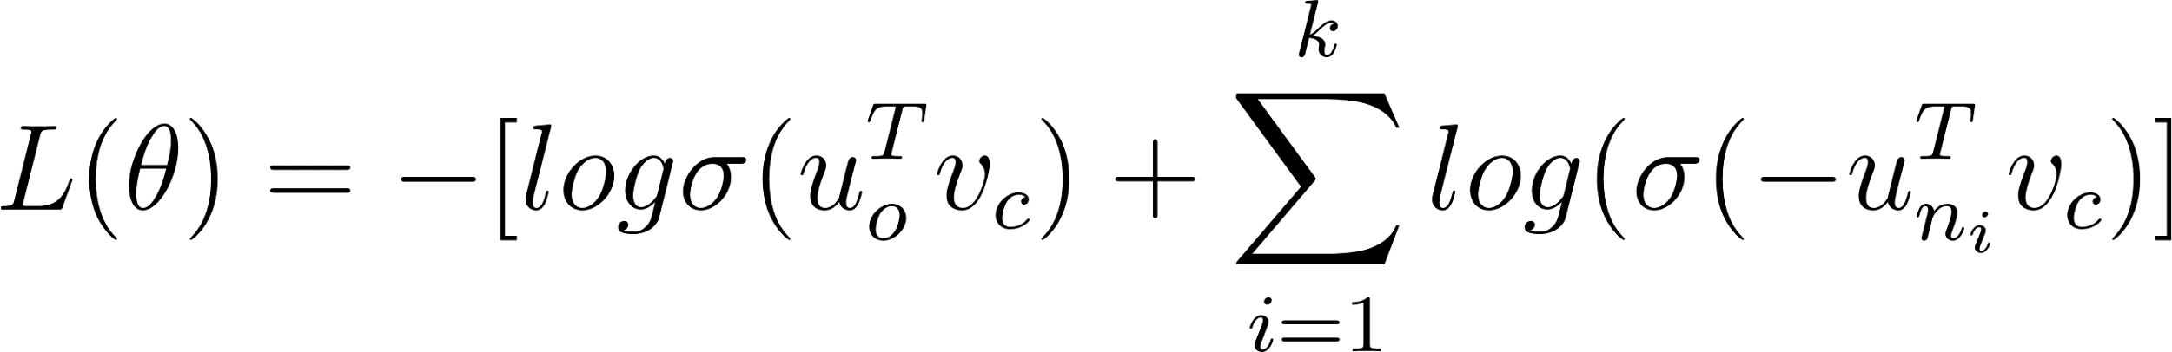
SNGS: objective function (single example)
which (per sigmoid formula) can be simplified as
Notes:
Remember: we want the quantity inside the parenthesis to be maximized, which means being close to zero, as its maximum is zero. How is that zero? It is zero if the stuff inside the log is as close as possible to 1 – aka, if the probability of the positive example is high, and the probability of the negative examples is 0.

Slide 47
SNGS: objective function (single example)
which (per sigmoid formula) can be simplified as
This (extended to all windows and all context words in the corpus) is the loss for SNGS.
As for softmax, the model uses this as a way to “test” how good its parameters (the vector matrices U and V) are, and update them based on values of the loss function
Notes:
Remember: we want the quantity inside the parenthesis to be maximized, which means being close to zero, as its maximum is zero. How is that zero? It is zero if the stuff inside the log is as close as possible to 1 – aka, if the probability of the positive example is high, and the probability of the negative examples is 0.

Slide 48
SNGS: putting it all together
First, we create a training dataset where, for each center word o, each training example contains a positive sample (c) and k negative samples (n_{i})
Then, for each example:
We look up the center vector for c from the matrix of center vectors V
We look up the context vectors for o and n_{1:k} from the matrix of context vectors U
We compute the dot product between the current center vector for o and context vectors for each of the positive and negative examples.
We compute the sigmoid of all these dot products (end of the forward pass)
We plug these into the loss function to compute how “wrong” the model is (error computation)
Based on this info we update the vector matrices U and V (backpropagation) and we try again!
This procedure incentivizes learning of vectors whose similarity in vector spaces reflects how related these words, i.e., their tendency to occur in the same context
Notes:
This assumes we do it on the full dataset, but in the end, we will do this only for a subset of data at the time

Slide 49
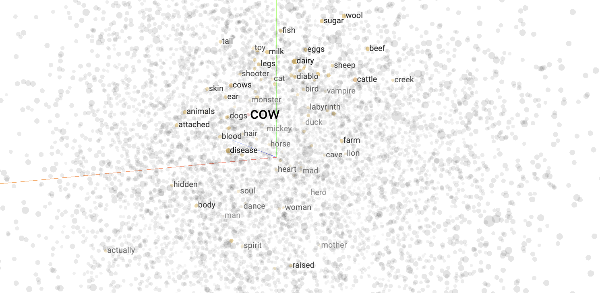
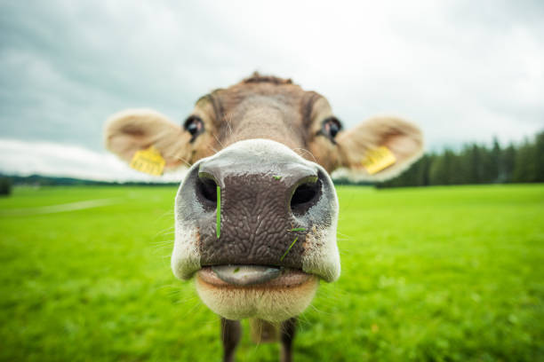
Notes:
This assumes we do it on the full dataset, but in the end, we will do this only for a subset of data at the time

Slide 50
SNGS: the neural network
All these computations are performed by layers of a neural network: let’s see how the architecture looks (we will formalize our intuitions on neural networks next week).

Slide 51
doubt: 50
index of “doubt” in vocabulary
apple: 4
This layer selects the nth vector/embedding from the context matrix V
V [vocab_size, n_dims] is the weights of this layer.
Weights are parameters of the network, which can be updated
This layer selects the nth vector/embedding from the context matrix U
U [vocab_size, n_dims] is the weights of this layer.
Embedding layer
(center words)
Embedding layer
(context words)
center vector v_{c} for “doubt” [n_dims]
context vector u_{n} for “apple” [n_dims]
Notes:
Spell out the dot product.
Actually, the embedding layer selects more rows, and then squeezes them with a sum (another layer) – indexing is differentiable because in the end it is a multiplication…
The embedding layer is a simplification of a linear layer. In linear layer, you pass vocabulary indices transformed into one-hot encodings of size [1,n_words]. These are multiplied by the layer’s weights, of size [n_words, n_dims]. The output of matrix multiplication is [1,n_dims]... This is basically a multiple linear regression!
Also re the loss: can either be batched with other examples, or calculated for individual examples and then the averaging over batches will do the job!

Slide 52
doubt: 50
index of “doubt” in vocabulary
apple: 4
This layer selects the nth vector/embedding from the context matrix V
V [vocab_size, n_dims] is the weights of this layer.
Weights are parameters of the network, which can be updated
This layer selects the nth vector/embedding from the context matrix U
U [vocab_size, n_dims] is the weights of this layer.
Embedding layer
(center words)
Embedding layer
(context words)
center vector v_{c} for “doubt” [n_dims]
context vector u_{n} for “apple” [n_dims]
Merge layer
(dot product)
computes dot product between the two vectors, v_{c} and u_{n}. This layer has no parameters, as its output depends uniquely from the inputs.
dot product between the two vectors (scalar)
Notes:
Spell out the dot product.
Actually, the embedding layer selects more rows, and then squeezes them with a sum (another layer) – indexing is differentiable because in the end it is a multiplication…
The embedding layer is a simplification of a linear layer. In linear layer, you pass vocabulary indices transformed into one-hot encodings of size [1,n_words]. These are multiplied by the layer’s weights, of size [n_words, n_dims]. The output of matrix multiplication is [1,n_dims]... This is basically a multiple linear regression!
Also re the loss: can either be batched with other examples, or calculated for individual examples and then the averaging over batches will do the job!

Slide 53
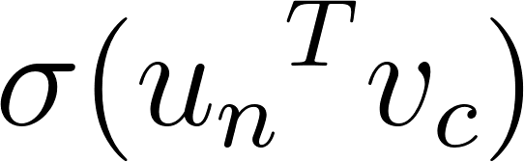
doubt: 50
index of “doubt” in vocabulary
apple: 4
This layer selects the nth vector/embedding from the context matrix V
V [vocab_size, n_dims] is the weights of this layer.
Weights are parameters of the network, which can be updated
This layer selects the nth vector/embedding from the context matrix U
U [vocab_size, n_dims] is the weights of this layer.
Embedding layer
(center words)
Embedding layer
(context words)
center vector v_{c} for “doubt” [n_dims]
context vector u_{n} for “apple” [n_dims]
Merge layer
(dot product)
computes dot product between the two vectors, v_{c} and u_{n}. This layer has no parameters, as its output depends uniquely from the inputs.
dot product between the two vectors (scalar)
Sigmoid layer (or activation layer)
Not really a layer per se, this just applies the sigmoid function to its input (also called an “activation” function, simply transforms the output of a layer)
Based on this (for positive and negative examples), compute the loss L
output:
Notes:
Spell out the dot product.
Actually, the embedding layer selects more rows, and then squeezes them with a sum (another layer) – indexing is differentiable because in the end it is a multiplication…
The embedding layer is a simplification of a linear layer. In linear layer, you pass vocabulary indices transformed into one-hot encodings of size [1,n_words]. These are multiplied by the layer’s weights, of size [n_words, n_dims]. The output of matrix multiplication is [1,n_dims]... This is basically a multiple linear regression!
Also re the loss: can either be batched with other examples, or calculated for individual examples and then the averaging over batches will do the job!

Slide 54
doubt: 50
apple: 4
Use this information to update the network weights. We will see next week how this update is performed!
Embedding layer
(center words)
Embedding layer
(context words)
center vector v_{c} for “doubt” [n_dims]
context vector u_{n} for “apple” [n_dims]
Merge layer
(dot product)
dot product between the two vectors (scalar)
Sigmoid layer (or activation layer)
Based on this (for positive and negative examples), compute the loss L
output:
Notes:
Here, we only have weights for these layers.

Slide 55
doubt: 50
apple: 4
At the end of this iterative process, U and V will be our word vectors (generally, the vector for a word is obtained by averaging its U and V vectors)
Use this information to update the network weights. We will see next week how this update is performed!
Embedding layer
(center words)
Embedding layer
(context words)
center vector v_{c} for “doubt” [n_dims]
context vector u_{n} for “apple” [n_dims]
Pretrained vectors are available online, e.g., through packages like gensim
Merge layer
(dot product)
dot product between the two vectors (scalar)
Sigmoid layer (or activation layer)
Based on this (for positive and negative examples), compute the loss L
output:
Notes:
Here, we only have weights for these layers.
Important note: paradigmatic similarity and syntagmatic similarity!

Slide 56
From unsupervised to (self)supervised learning
Count-based approaches are unsupervised: they do not rely on any labelled data or external training signals to learn representations of the input data
there is no “ideal” target representation the model is aiming to achieve
This is in contrast with supervised learning, which is any algorithm that learns by leveraging labels as training signals
Word2vec is a special form of supervised learning:
No external labels
But there is some label (the correct words in a given context)
This is called self-supervised learning, as the labels used at training are inferred from the data

Slide 57
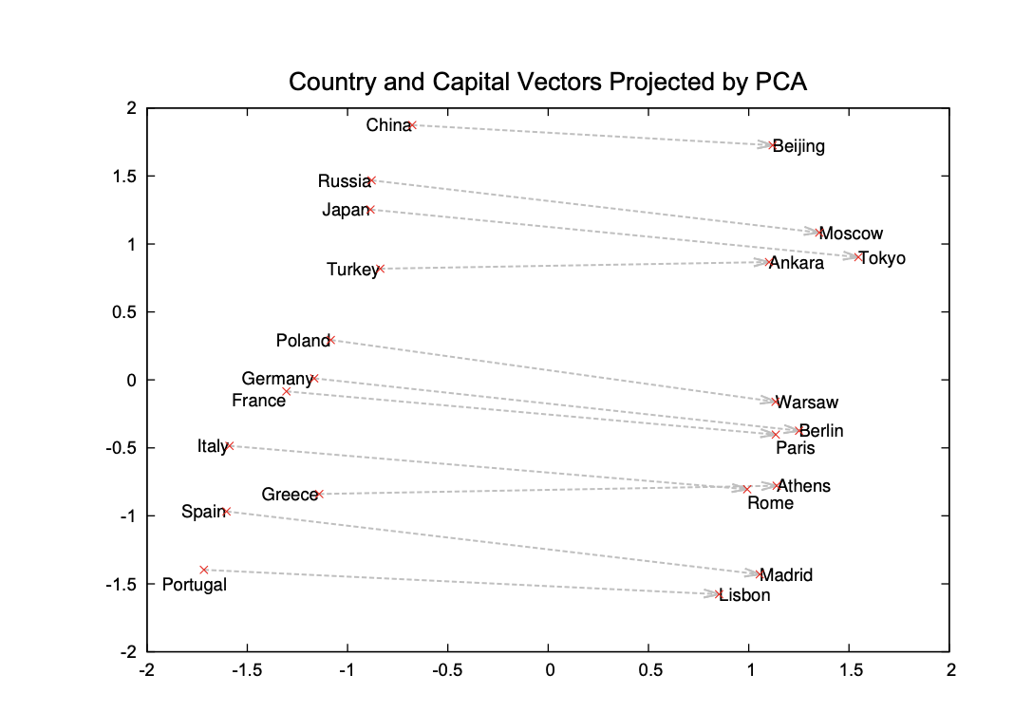
Many semantic relations are preserved
Remember last lecture?

Slide 58
Biases in vector representations
These models learn from data: if data is biased (e.g., with implicit semantic associations), the resulting vectors will be biased
Remember the analogy task?
Man : Computer Programmer = Woman: homemaker ?!? (Bolukbasi et al., 2016)
“Biases” can be analyzed by looking at specific types of semantic relations in vector spaces
?
king
woman
man

Slide 59
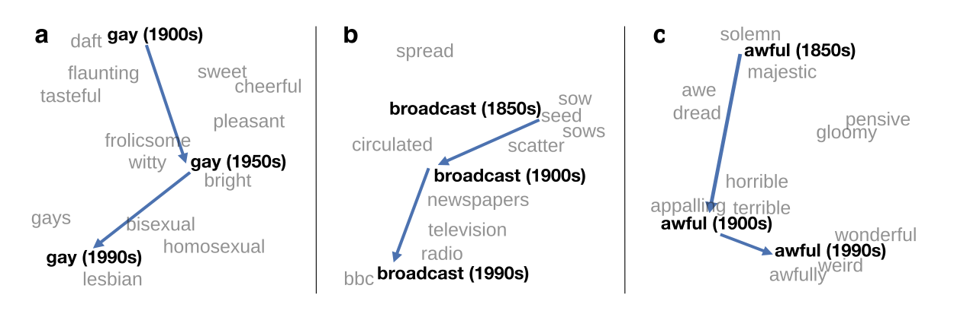
Biases as heuristics
Kozlowski et al (2019) use word embedding models to conduct an historical analysis of social class
Garg et al (2018) argue that word embeddings can be used to study how gender and ethnic stereotypes changed over time in 20th and 21st century American society
Moral: the fact that these NLP models encode biases is unavoidable – but not necessarily a bad thing
Hamilton et al (2016)
Notes:
Biases are… statistical properties of text!

Slide 60
Note: tokenization
What is a word?
Tokenization is the process of turning text into “tokens”, e.g., individual words whose representation we want to learn
Traditional NLP pipelines include many preprocessing steps before tokenization
lowercasing
lemmatization (e.g., painted -> paint, was -> is)
punctuation removal
Some of these transformations simplify the model to be learned, but they remove semantic information (e.g., verb tenses)
For word2vec models trained on large data (and, as we will see, for transformer), only minimal preprocessing is applied (e.g., lowercasing and splitting)

Slide 61
What Word2Vec does not solve
Words have different senses (e.g., bank) which can be disambiguated using surrounding context, but static vectors resulting from word2vec reduce them to a single representations and only represent words in isolation
Representations of sentences can be obtained by coarsely aggregating word vectors, but this yields mixed results
Practically, these models are not natively suited to any sequence-based task (e.g., translation)
In other words, compositionality and context-dependence are not adequately accounted for by this model
Some of these problems will be solved by sequence models and, finally, by transformers!

Slide 62
Other types of word embeddings
Note on terminology: word vectors and word embeddings are equivalent and they apply both to count-based and prediction-based models (though most often used for Word2Vec)
We looked at word2vec using skip-gram with negative sampling
CBOW with word2vec works in a broadly similar way
GloVe embeddings optimizes corpus-level statistics
Trained to optimize of probabilities from word—word co-occurrence matrix
Similar training methods used by word2vec
Perform better than word2vec, but probably because of better data quality
fasttext uses subword embeddings
Words are broken down into character n-grams (rather than “words”)
This makes it possible to deal with out-of-vocabulary tokens
We’ll look more at subword embeddings later in the semester

Slide 63
Beyond static embeddings
Static word embeddings
word2vec, GloVe, fastText
Dynamic (contextual) word embeddings – modulated by surrounding context, this accounts for compositionality <-> context-dependency
BERT, GPT-3, T5
Today, we have looked at static embeddings; we’ll come back to contextual embeddings later in the semester

Slide 64
Tomorrow: Exploring word embeddings!

Slide 65
SNGS: objective function (single example)
But how is this loss used to learn the parameters?
Notes:
Remember: we want the quantity inside the parenthesis to be maximized, which means being close to zero, as its maximum is zero. How is that zero? It is zero if the stuff inside the log is as close as possible to 1 – aka, if the probability of the positive example is high, and the probability of the negative examples is 0.

Slide 66
Tomorrow: Exploring word embeddings!
Next week:
How are parameters learned based on the loss function?
Gradient descent (on a simpler case: simple logistic/binary classification)
Intro to neural networks
Backpropagation

Slide 67
See you tomorrow!

Slide 68
even more readings if you are curious
Bolukbasi, T., Chang, K. W., Zou, J. Y., Saligrama, V., & Kalai, A. T. (2016). Man is to computer programmer as woman is to homemaker? debiasing word embeddings. Advances in neural information processing systems, 29.
Garg, N., Schiebinger, L., Jurafsky, D. & Zou, J. (2018). 'Word embeddings quantify 100 years of gender and ethnic stereotypes', PNAS, 16, E3635-E3644. DOI: 10.1073/pnas.1720347115
Kozlowskia, A.C., Taddyb, M., Evansa, J.A. (2019). 'The Geometry of Culture: Analyzing the Meanings of Class Through Word Embeddings', American Sociological Review, 84(5), 905-949. DOI: 10.1177/0003122419877135
Hamilton, W.L., Leskovec, J., & Jurafsky, D. (2016). ‘Diachronic word embeddings reveal statistical laws of semantic change’, Proceedings of the 54th Annual Meeting of the Association for Computational Linguistics (Volume 1: Long Papers). DOI: 10.18653/v1/P16-1141
Utsumi, A. (2020). ‘Exploring What Is Encoded in Distributional Word Vectors: A Neurobiologically Motivated Analysis’, Cognitive Science: A Multidisciplinary Journal, 44(6). DOI: 10.1111/cogs.12844
Weng, Lilian (2017). ‘Learning Word Embedding’, https://lilianweng.github.io/lil-log/2017/10/15/learning-word-embedding.html [Retrieved Oct. 2022].

Slide 69
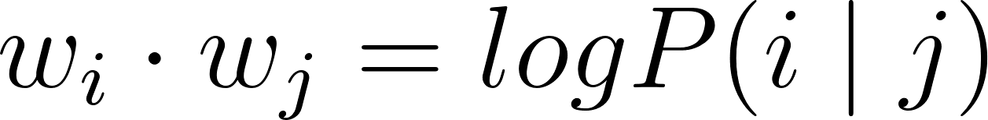
The GloVe model (Pennington, Socher, and Manning, 2014)
Another method to train vectors (based on linguistic intuition)
Lightweight training method:
Compute probabilities of co-occurrence for each vector pairs
Subset only non-zero values (for efficiency)
Train word vectors such that:
Due to properties of logarithms, it can be demonstrated that differences in the resulting vectors encode semantic relations
One of the best performing models (on par with word2vec) for many tasks…
Available pretrained vectors that can be re-used
Notes:
ones we saw before)

